Slide 1
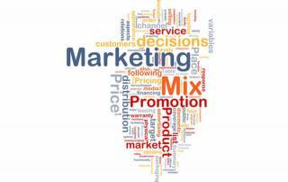
Digital Marketing Mix
Dr. J. SUNDARARAJ
Associate Professor of Commerce,
Annamalai University

Slide 2
What is (Digital) Marketing Mix?
The marketing mix is one of the most famous marketing terms.
The marketing mix is the tactical or operational part of a marketing plan.
The marketing mix is also called the 4 Ps and the 8 Ps.
The marketing mix is the combination of elements used by a business to enable it to meet the needs and expectations of customers
The challenge for marketing is to ensure that the elements of the mix work together to achieve the marketing objectives.

Slide 3
Definition of (Digital) Marketing Mix
The marketing mix is . . . The set of controllable tactical marketing tools – product, price, place, and promotion – that the firm blends to produce the response it wants in the target market. - Kotler and Armstrong (2010).
The DIGITAL MARKETING MIX is essentially the same as the to the digital marketing context. Of coursmarketing mix. It is simply the adaptation of price, place, product and promotione one could also include, people, process, Programs and Performance or physical evidence when marketing planning for an digital service. -
Markets can apply the digital marketing mix to their organization’s own product, service, brand or solution.

Slide 4
Elements of Digital Marketing Mix
Digital Marketing Mix
Product
Price
Place
Promotion
People
Process
Programs
(Physical Evidence )
Performance

Slide 5
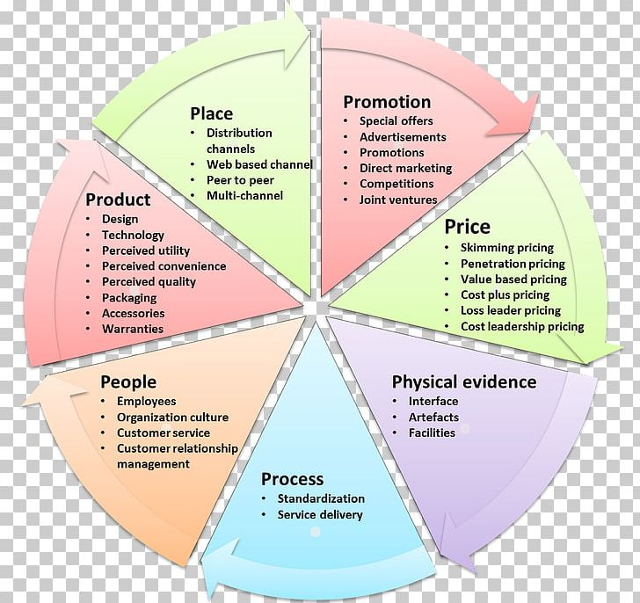

Slide 6
PRODUCT
“Product means the goods-and-services combination the company offers to the target market. - Kotler and Armstrong (2010).
“Product is not only tangible, but technically a Product is anything that can be offered to a market to satisfy a want or need, including physical goods, services, experiences, events, persons, places, properties, organisations, information and idea”. - Kotler and Keller (2016)
“A product is a set of tangible and intangible attributes, including packaging, colour, price , manufacturer’s prestige, retailer’s prestige and manufacturer’s and retailer’s services, which the buyer may accept as offering satisfaction or wants or needs. - William J. Stanton
While planning market offering, the marketer needs to address Five Product Levels.
Each level adds more Customer Value, and together the five constitute a Customer-value Hierarchy.

Slide 7
Product Levels – The Customer-Level Hierarch

Slide 8
Product Attributes
A number of attributes will be added in order to differentiate product from its competitors.
The attributes will include a variety of additional features, quality levels, design, branding, customer service etc.
The attributes are developed to meet the needs of the target market and provide a competitive advantage for the product.
The product attribute decisions:-
Product Quality - refers to the ability of the product item to perform its intended functions - durability, reliability, precision, performance and ease of operation.
The selection of quality level depends on the Target market and Positioning
Product Features – in addition to core benefit product, the firm must offer features that a consumer would expect. - important product differentiation
Product Design –indicates its usefulness as well as makes it attractive.
Products can be distinguished with its unique style/design which helps to create a distinct “Personality” for the Product.
A distinctive design is difficult to create, relatively rare and usually expensive.
mass market goods – standard styles

Slide 9
Product Polices
General rules set up by the management in the product decisions
Good product policies are the basis on which the right products are produced and marked successfully.
Determine the success or failure of the firm
“Product Policy is concerned with defining the type, volume and timing of the product a company offer for sale”
The product policy is the objectives and guidelines, which determine the nature of the product or services, to be marketed.
Product Planning and Development
Product Line
Product Mix
Product Branding (Identification)
Product Style
Product Positioning
Product Packaging

Slide 10
Product Mix
Product mix (Product Assortment) is the set of all products and items that a particular seller offers for sale to buyers
- Philip Kotler
Product mix (Product Assortment) – total number of product lines a company offers to its customers.
Dimensions of Product Mix
Product Mix Width – Number of Product Lines
refers to how many different product lines the company caries
Product Mix Length – Total Products or items
refers to the total number of items in the mix
Product Mix Depth – Product Variations – size , flavour colours
refers to how many variants are offered of each product in the line
Product consistency – How closely related product lines
refers to how closely related the various product lines are in end use,

Slide 12
Classification of Products
Two types of products are distinguished based on who will use them and how they will be used.
Consumer Products are intended for use by household consumes for non-business purposes.
Business Products are intended for resale, for use in producing other products, or for providing services in an organisation.

Slide 13
Classification of Consumer Products
Convenience Goods: A product that the consumer knows enough about before going out to buy it and then actually buys it with a minimum of effort is termed as Convenience good.
- William J. Stanton
Shopping Goods: A tangible product for which consumers want to compare quality, price, and perhaps style in several stores before making a purchase is considered a Shopping Good.
-William J. Stanton
Specialty Goods: A tangible product for which consumers have a strong brand preference and are willing to expend substantial time and effort in locating the desired brand is called a Speciality Good.
- William J. Stanton
Unsought Goods: is a new product that the consumer is not yet aware of or a product that the consumer is aware of but does not want right now.
- William J. Stanton

Slide 14
Digital Price
Price is the amount the consumer must exchange to receive the offering .
Solomon et al (2009).
“ Price is the amount of money which is needed to acquire in exchange of some combined assortment of a product and its accompanying services”
W. J. Stanton
“ Price is the only element in the marketing mix that creates sales revenue; the other elements are costs” - Philip Kotler
The digital marketing mix is simply an adaptation of the traditional marketing mix, and ‘P’ for price. However, the Internet has influenced how online businesses price in a number of ways.
Price is the one element of the marketing mix that produces revenue and other elements produce costs.

Slide 15
Special Features of Digital Pricing Models
Reduction of Intermediaries cost through digital channels
People buy products online for convenience and cost – reduce intermediaries
Knowledge of Customer Buying Habits and Propensity
Helps to create cluster/persona-specific and channel-specific pricing
Economic Pressures and Possibility of Instant Price Comparisons Online
Possibility of on the spot price comparisons
Ability for Consumers to set and Negotiate Online Prices
Online Auction –Ebay – customers can barter products at self-set prices – Price control
Customer’s Demand for Payment Elasticity
Young people need easy payment options –extended payment instalments
Possibility of Content Modularity and Digitisations
Easy availability of customised digital product like information, books, music, entertainment, gams, etc.
Markets need to develop accurate and predictive pricing models
Possibility of Innovative Business Models
In-Game Payment, App Subscription, Donations, Pay As you Wish, etc

Slide 16
Pricing Objectives
To profit maximisation
To earn target return (ROI)
To face competition
To increase market share
To Enter new market
To keep Competition out
To keep parity with competition
To attain a Target Market
To bring Price Stability
To survive in Competition Field
To balance Price over Product Line

Slide 17
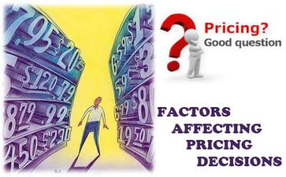
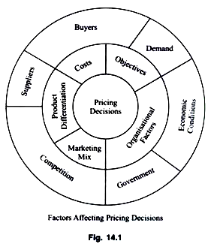
Factors Affecting Pricing Decisions
Internal Factors
Organisational Factors
Marketing Mix
Product Differentiation
Cost of the Product
Objectives of the Firm
External Factors
Demand
Competition
Suppliers
Economic Conditions
Buyers
Government

Slide 18
Setting the Price Model
Selecting the Pricing Objectives
Digital Strategy – kind of revenue, market share and profit objectives – type of channel, kind of customer segments targeted – consumption patterns on those channels and sites
Determining Demand
Inverse relationship between price and demand
Different prices for different categories and lines
Varied pricing depending on the kind of site, audience, landing page, and even the day and time are selling their multi-portfolio products
Estimating Costs
Because of Internet, lower of intermediaries overheads
However, infrastructure and technology overhead cost – website maintenance, server set-up, online security, development cost - accurately estimated to fix price
Analysing Competitor’s Costs, Prices and Offers
Digital medium is price –sensitive – customer have access to data points on each product price
Pricing model should not only predict and pre-empt key competitors’ price moves, but also competitive enough to bigger discounts or bundling options
Selecting a Pricing Method
Setting the Final Price
Digital world offers flexibility in adapting prices –Amenable to quick changes
Major impact on Digital pricing comes in the form of Promotions and deals which are common to online landscape

Slide 19
Pricing Polices
Cost based Pricing Policy
Cost Plus pricing
Target Pricing
Break-even Pricing
Demand Based Pricing Policy
Cost-Demand based Pricing Policy
Competition based Pricing Policy
Meeting the competition
Pricing above the Competition
Pricing under the Competition

Slide 20
Pricing Strategies
The pricing decisions to fit the competitive situations by specific products are referred pricing strategies.
Pricing Policies are general and long term guidelines while pricing strategies are specific and in effect for shorter period to meet competitive situation changes.
Firms do not set a single price
Pricing structure changes through Product life cycle
Prices will reflect changes in the environment – cost, demand, competition etc
New Product Pricing Strategies
Pricing of Imitative Product
Product Mix Pricing Strategies
Price Adjustment Strategies

Slide 21
Digital Place
Place includes company activities that make the product available to target consumers. - Kotler and Armstrong (2010).
Place is also known as channel, distribution, or intermediary.
It is the mechanism through which goods and/or services are moved from the manufacturer/ service provider to the user or consumer.

Slide 23
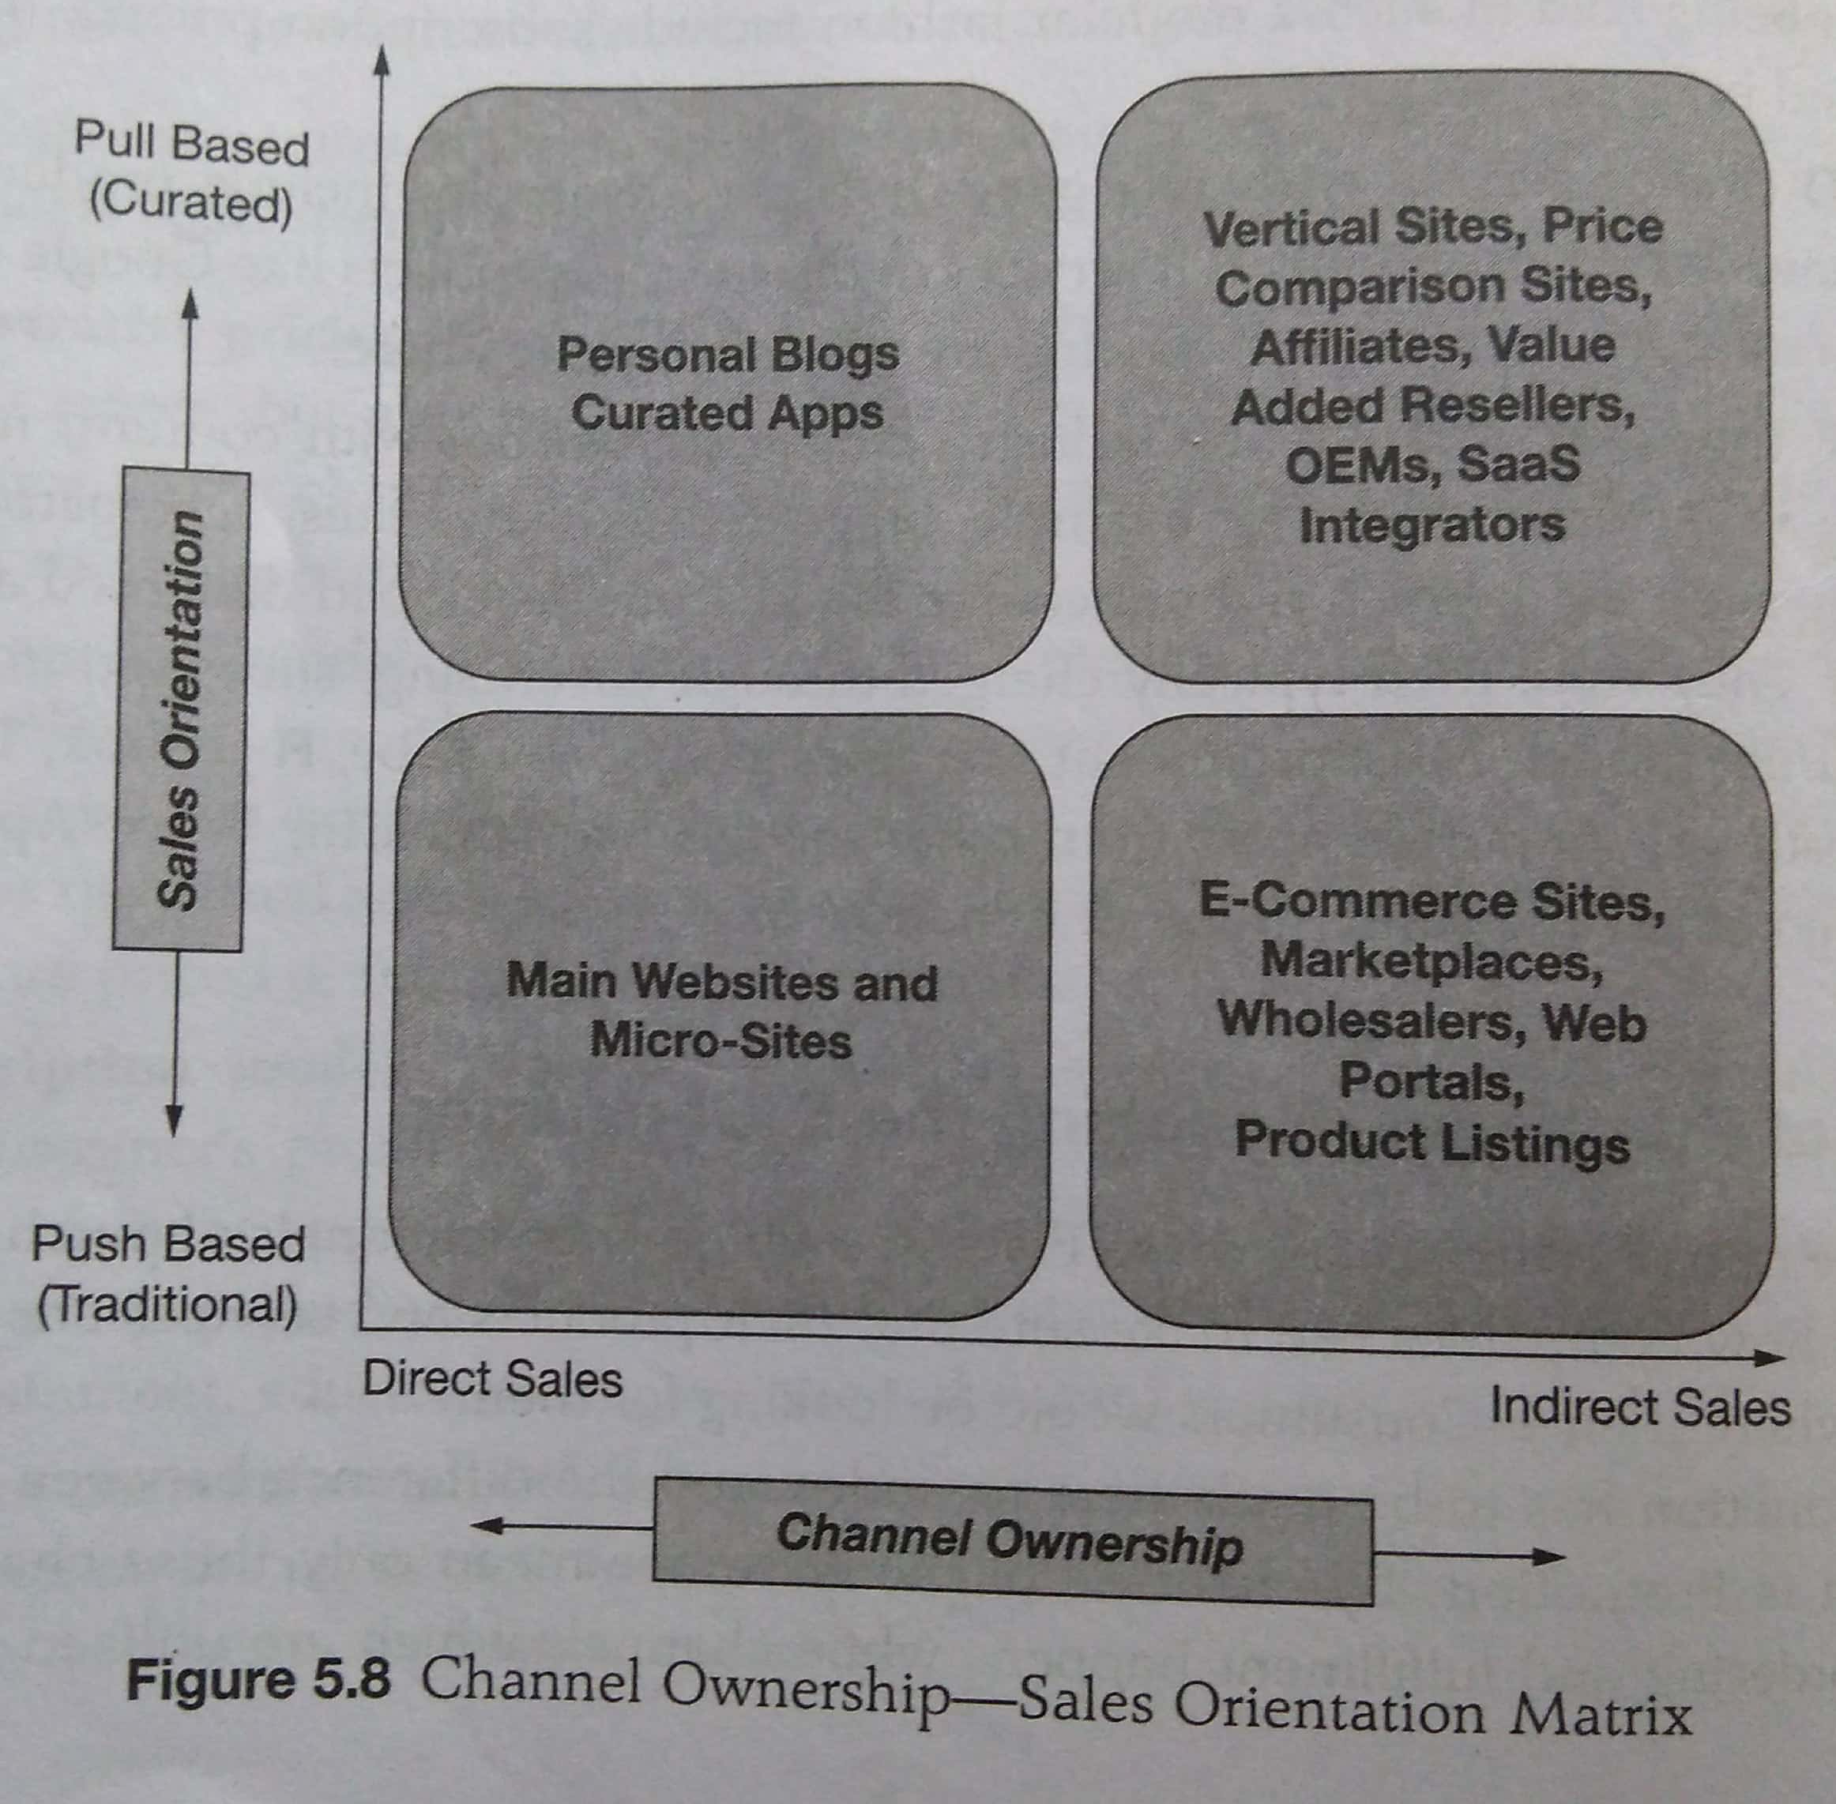

Slide 24
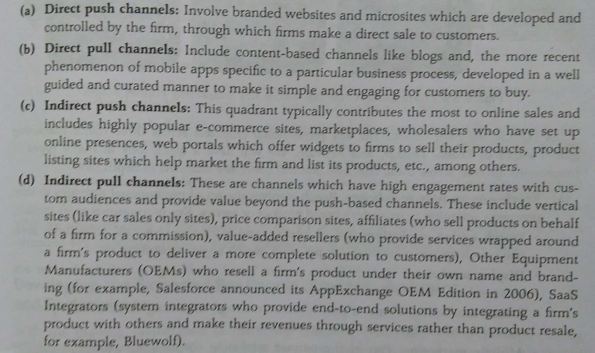

Slide 25
Digital Promotion
Promotion includes all of the activities marketers undertake to inform consumers about their products and to encourage potential customers to buy these products.
Solomon et al (2009).
Promotion includes all of the tools available to the marketer for marketing communication.
As with Neil H. Borden’s marketing mix, marketing communications has its own promotions mix. Whilst there is no absolute agreement on the specific content of a marketing communications mix, there are many promotions elements that are often included such as sales, advertising, sales promotion, public relations, direct marketing, online communications and personal selling.

Slide 26
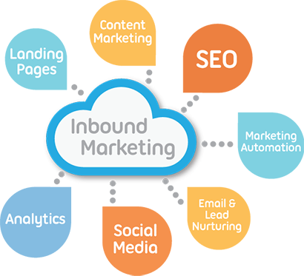
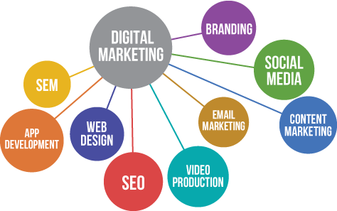

Slide 28
Extended Marketing Mix

Slide 29
Extended Digital Marketing Mix
Extended
Digital Marketing Mix
People
Processes
Programs
Performance

Slide 30
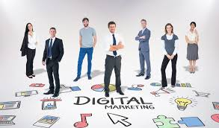
People
(People are) . . . All human actors who play a part in service delivery and thus influence the buyers’ perceptions; namely, the firm’s personnel, the customer, and other customers in the service environment.
- Zeithaml et al (2008).
People are the most important element of any Digital service or experience.
Digital Services tend to be produced and consumed at the same moment, and aspects of the customer experience are altered to meet the individual needs of the person consuming it.

Slide 31
PEOPLE
Involves developing online teams with a mix of digital marketing expertise, technology know-how, multi-channel experience, knowledge of automation tools, and most of all, target customer insights.
It also involves how to look at customers with all their human impulses and desires to know what would entice them most towards marketing efforts both on the content and creative side.

Slide 32
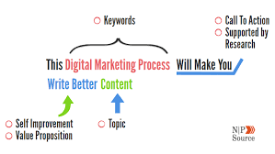
Process
Process is) . . . The actual procedures, mechanisms, and flow of activities by which the service is delivered – this service delivery and operating systems.
- Zeithaml et al (2008).
There are a number of perceptions of the concept of process within the business and marketing literature.
A digital marketing process is a broad term to explain any number of steps you take to achieve a digital strategy.
It might have a digital marketing process to curate content, schedule posts, and engage with your audience as part of your social media strategy
Some see processes as a means to achieve an outcome, for example – to achieve a 30% market share a company implements a marketing planning process.
However in reality it is more about the customer interface between the business and consumer and how they deal with each other in a series of steps in stages, i.e. throughout the process.

Slide 33
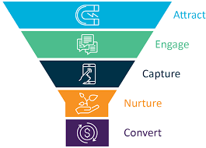
Processes
Involves developing a rigorous process-driven marketing organisation which lays down clear steps
to understand and identify target customer clusters,
develop thought-through and tightly integrated supplier-customer processes and
manage campaigns
as a series of processes with clearly aligned goals parallel to consumer funnel activities, with ways and means to refine them as needed.

Slide 34
Programs
Programe involves the set of all traditional and digital marketing activities which the marketer would run in parallel where each one would leverage the other to execute an integrated marketing programme.
It is defined as the entire set of consumer-driven programs which are run in a holistic manner online and offline to meet a firm’s marketing objectives.
It also includes all the multi-channel initiatives which are taken across traditional and new platforms to make sure that customers at all stages, be it targets, prospects, or leads are touched upon and impacted in a 360-degree manner.

Slide 35
Performance
It means planning for and exhibiting not only business performance but also being seen as a company that has an impact on environment and society as a whole.
Performance relates to capturing and measuring the range of possible outcome measures that have financial and non-financial implications – Profitability as well as brand and customer equity and those beyond the company itself – Social Responsibility, legal, ethical and community related.

Slide 36
Performance
The final P related to setting up systems and ways to measure performance and desired outputs at each stage of the marketing activity, through well-defined metrics and KPIs (Key Performance Indicators).
Performance evaluation should touch all of the other Ps to continually refine the offering mix, related pricing offered, performance of various channels of purchase, and the extent of impact brought about by various promotional set-ups.

Slide 37
Physical Evidence
(Physical evidence is) . . . The environment in which the service is delivered, and where the firm and customer interact, and any tangible components that facilitate performance or communication of the service.
- Zeithaml et al (2008)
Physical Evidence is the material part of a service.
Strictly speaking there are no physical attributes to a service, so a consumer tends to rely on material cues.
There are many examples of physical evidence, including some of the following buildings, equipment, signs and logos, annual accounts and business reports, brochures, your website, and even your business cards.

